Slide 1


Security with shared source code repositories
Cody Ferre
10/04/2024
CSD380-O302

Slide 2

What you are Protecting
Source Code and its integrity and stability for the applications it runs.
Intellectual Property, the code is still property of the company and has value.
People's Information, from passwords to important encryption keys can cause data breaches and leak vital information for customers and employees.

Slide 3
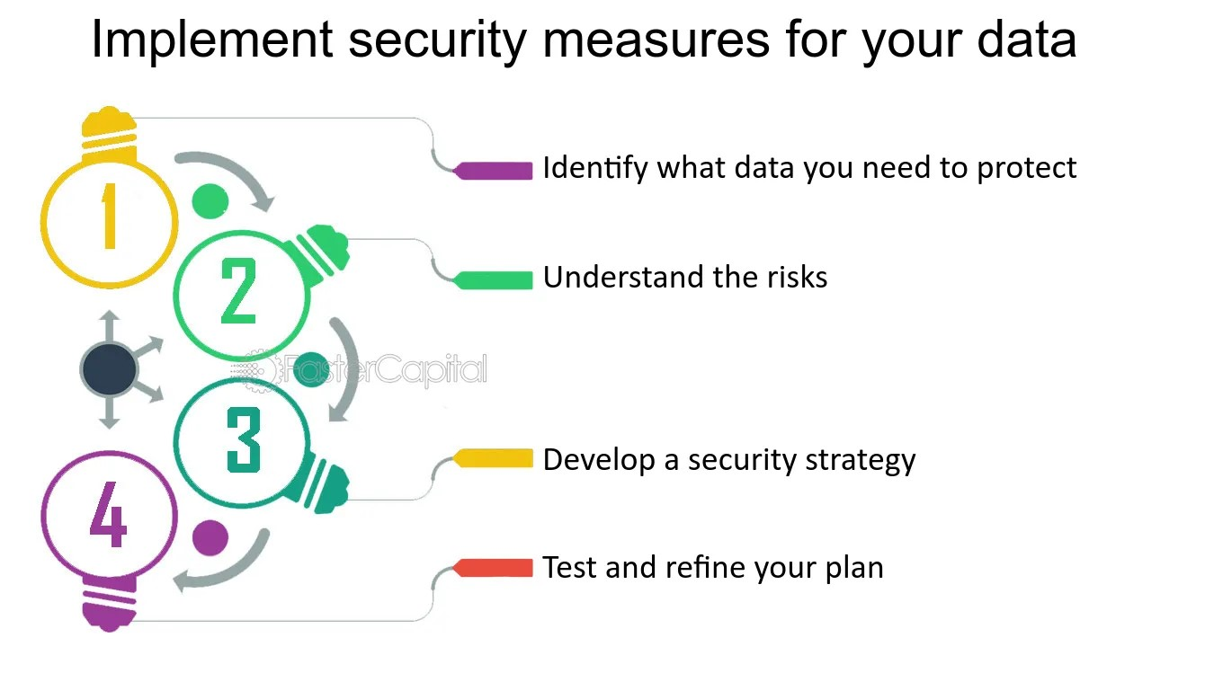
Best Practices for Security
Control Access – When protecting documents and code its best to limit user access with multi-factor authentication, least-privilege user access.
Incident Response – If something does breach, have a plan to respond to the threat or maintain damage and recovering from the attack.

Slide 4

Best Practices Part Two
Encryption – Can only encrypt the stored or transferred data and cannot be for the source code, still effective if data is intercepted at all.
Off-Site Backup – To protect from someone stealing the backup.
Secure Repository – Take advantage of systems in place like GitHub which has its own encryption and access controls.

Slide 5

Best Practices Part Three
Monitoring Systems – Set of systems to look for irregularities or unauthorized access
Security Audits – Review the source code to update, remove exploits and maintain to stop threats using testing toolkits.
Personal Security – Keep practices in mind on your own personal online security, passwords, data and web browsing.

Slide 6
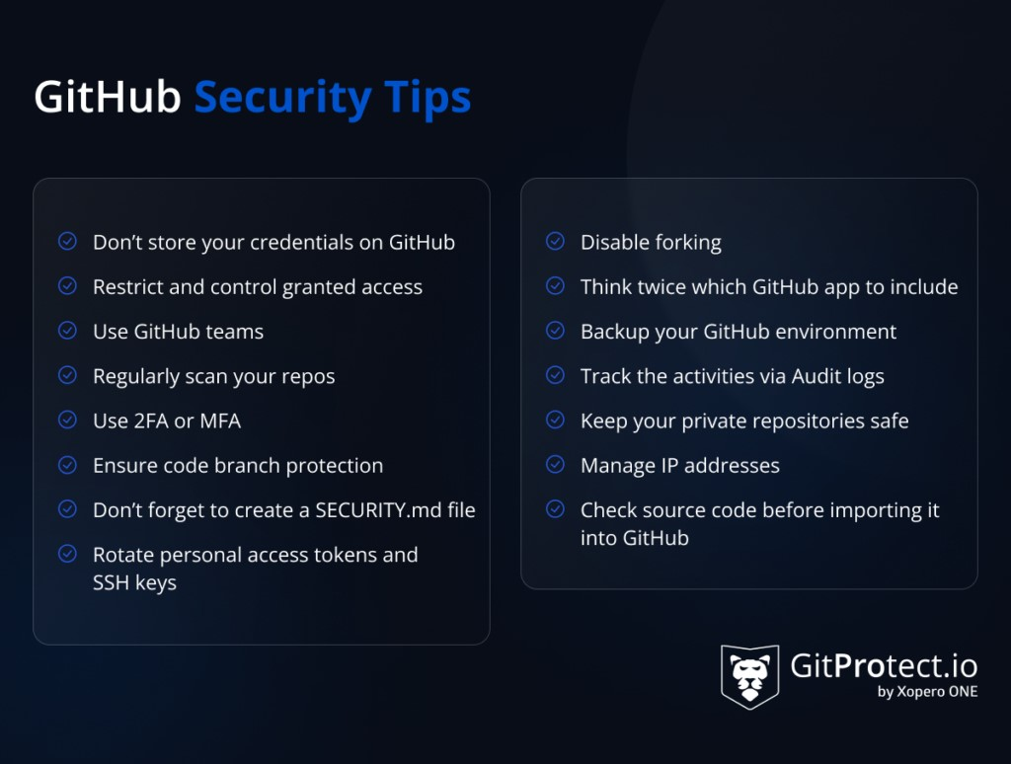

Slide 7
Citations
Chris Brook, May 2, 2024, Source Code Security Best Practices to protect against theft, Digital Guardian, https://www.digitalguardian.com/blog/source-code-security-best-practices-protect-against-theft
Beata Berecki, April 8, 2022, Best Practices for source code, endpointprotector, https://www.endpointprotector.com/blog/your-ultimate-guide-to-source-code-protection/
Secure development and deployment guidance, National Cyber Security Centre, https://www.ncsc.gov.uk/collection/developers-collection/principles/protect-your-code-repository
Mark Clement, Source Code Security Best Practices, stop-source-code-theft, https://www.stop-source-code-theft.com/source-code-security-best-practices/
August 2023, Appendix 3 – Oracle Source Code Protection and Secure Development, Oracle, https://www.oracle.com/assets/supplier-security-standards-app3-2895271.pdf

